Slide 1
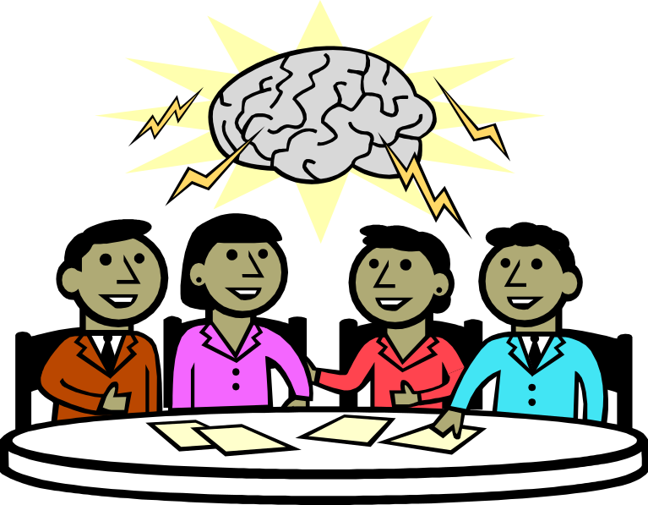
Neural Networks
Building Artificial Brains

Slide 2
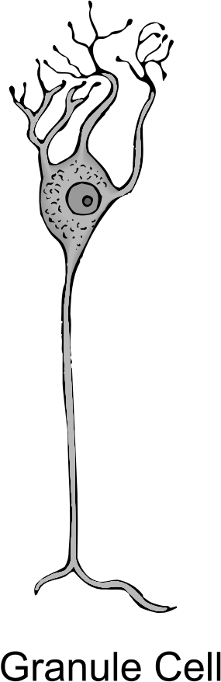
Crash Course in Neurobiology
So You Want to Be a Brain Surgeon
Synapses
Nerve cells are specialized to send and receive signals.
They contain conductive materials & structures to do so.
Important Parts
Axon – sends signals
Dendrites – pick up signals
Synapses – connections; control signal flow
Synapses…
Allow us to learn by changing over repeated stimulation
Increase or decrease the strength of passing signals
Most-used synapses increase signal strength
Less-used synapses reduce signal strength
Synapse strengths are changed through error correction
Nerves also help store memories in humans.
Dendrites
Axon

Slide 3

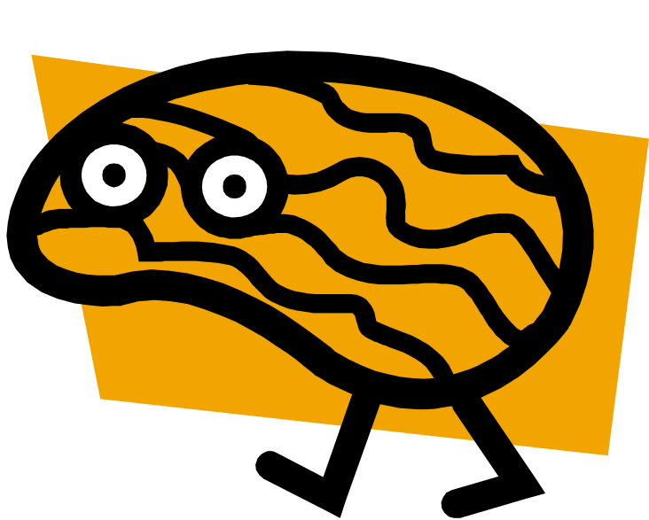

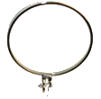

Brains
How are they different?
Some Brain Statistics
~85 billion individual neurons
Heavily interconnected network
(~7,000 synapses per neuron)
Largest (?) neural net:
(Stanford, 2013)
  ~20 million neurons?
  ~11 billion synapses
  ~4 orders of magnitude short
Signal rate of ~10 ms / transmission
Draws ~20 watts of power
Three cheers for brains!
I am not a peanut!
<grumble>

Slide 4


Nerve Cell Model
Input
Axon
Synapses
Input
x₁w₁
Learning weights
Value
x₂w₂

Slide 5
Neurons
Multilayer Perceptron Model
Input
(at most 1 layer)
Hidden
(1 or more layers)
Output
(1 layer)
6
1
2
1
4
2
7
3
1
2
1
3
2
3
1
1
2
5
8
2
3
9

Slide 6
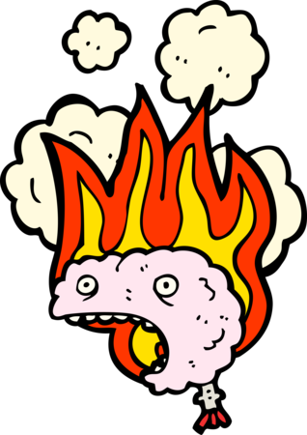
Neural Networks
Benefits & Drawbacks
Benefits:
Can tackle difficult, poorly understood AI problems
Don’t require hand-coding
Very flexible
Can output numerical values, not just true/false
Fast, after training is complete
Drawbacks:
Inefficient at many tasks
May not always find a good solution (can get stuck on local maxima)
Challenging to implement, debug, and control (they are “black boxes”)
Training can be time-intensive and may have to be done many times
Good training sets can be difficult and time-consuming to construct
Despite their limitations, neural networks are occasionally used in games, like the Forza series, the Democracy series, and Supreme Commander 2. Overall, though, they are not used much in games today.

